Slide 1

Module 8.1 – Parallel Computation Patterns (Stencil)
Convolution

Slide 2
Objective
To learn convolution, an important method
Widely used in audio, image and video processing
Foundational to stencil computation used in many science and engineering applications
Basic 1D and 2D convolution kernels

Slide 3
Convolution as a Filter
Often performed as a filter that transforms signal or pixel values into more desirable values.
Some filters smooth out the signal values so that one can see the big-picture trend
Others like Gaussian filters can be used to sharpen boundaries and edges of objects in images..

Slide 4
Convolution – a computational definition
An array operation where each output data element is a weighted sum of a collection of neighboring input elements
The weights used in the weighted sum calculation are defined by an input mask array, commonly referred to as the convolution kernel
We will refer to these mask arrays as convolution masks to avoid confusion.
The value pattern of the mask array elements defines the type of filtering done
Our image blur example in Module 3 is a special case where all mask elements are of the same value and hard coded into the source code.

Slide 5
1D Convolution Example
N
N[0]
N[1]
N[2]
N[3]
N[4]
N[5]
N[6]
P
P[0]
P[1]
P[2]
P[3]
P[4]
P[5]
P[6]
1
2
3
4
5
6
7
3
8
57
16
15
3
3
M
M[0]
M[1]
M[2]
M[3]
M[4]
3
4
5
4
3
3
8
15
16
15
Commonly used for audio processing
Mask size is usually an odd number of elements for symmetry (5 in this example)
The figure shows calculation of P[2]
P[2] = N[0]*M[0] + N[1]*M[1] + N[2]*M[2] + N[3]*M[3] + N[4]*M[4]

Slide 6
Calculation of P[3]
N
N[0]
N[1]
N[2]
N[3]
N[4]
N[5]
N[6]
P
P[0]
P[1]
P[2]
P[3]
P[4]
P[5]
P[6]
1
2
3
4
5
6
7
3
8
57
76
15
3
3
M
M[0]
M[1]
M[2]
M[3]
M[4]
3
4
5
4
3
6
12
20
20
18

Slide 7
Convolution Boundary Condition
N
N[0]
N[1]
N[2]
N[3]
N[4]
N[5]
N[6]
P
P[0]
P[1]
P[2]
P[3]
P[4]
P[5]
P[6]
0
1
2
3
4
5
6
7
3
38
57
16
15
3
3
Filled in
M
M[0]
M[1]
M[2]
M[3]
M[4]
3
4
5
4
3
0
4
10
12
12
Calculation of output elements near the boundaries (beginning and end) of the array need to deal with “ghost” elements
Different policies (0, replicates of boundary values, etc.)

Slide 8
A 1D Convolution Kernel with Boundary Condition Handling
This kernel forces all elements outside the valid input range to 0
__global__ void convolution_1D_basic_kernel(float *N, float *M, float *P, int Mask_Width, int Width)
{
int i = blockIdx.x*blockDim.x + threadIdx.x;
float Pvalue = 0;
int N_start_point = i – (Mask_Width/2);
for (int j = 0; j < Mask_Width; j++) {
if (N_start_point + j >= 0 && N_start_point + j < Width) {
Pvalue += N[N_start_point + j]*M[j];
}
}
P[i] = Pvalue;
}

Slide 9
A 1D Convolution Kernel with Boundary Condition Handling
This kernel forces all elements outside the valid input range to 0
__global__ void convolution_1D_basic_kernel(float *N, float *M, float *P, int Mask_Width, int Width)
{
int i = blockIdx.x*blockDim.x + threadIdx.x;
float Pvalue = 0;
int N_start_point = i – (Mask_Width/2);
if (i < Width) {
for (int j = 0; j < Mask_Width; j++) {
if (N_start_point + j >= 0 && N_start_point + j < Width) {
Pvalue += N[N_start_point + j]*M[j];
}
}
P[i] = Pvalue;
}
}

Slide 10
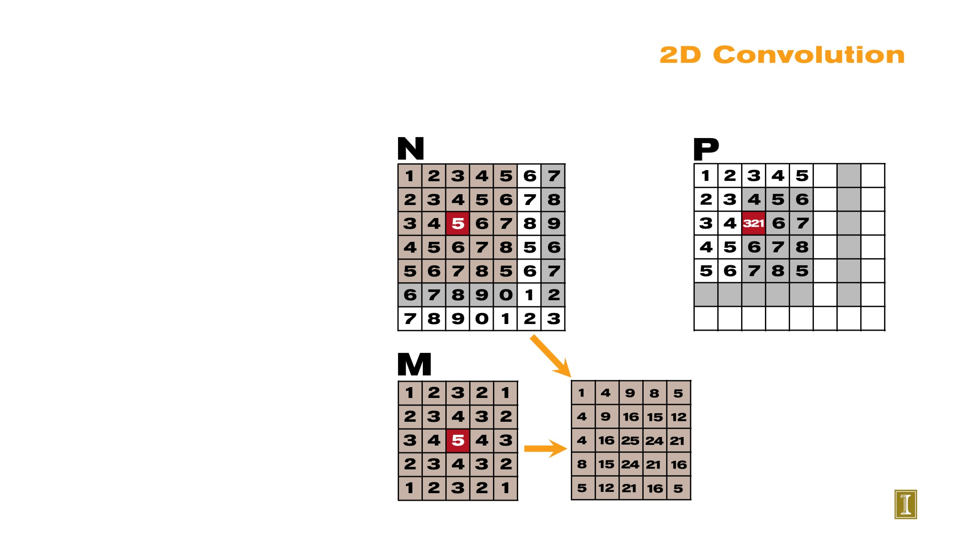
2D Convolution

Slide 11
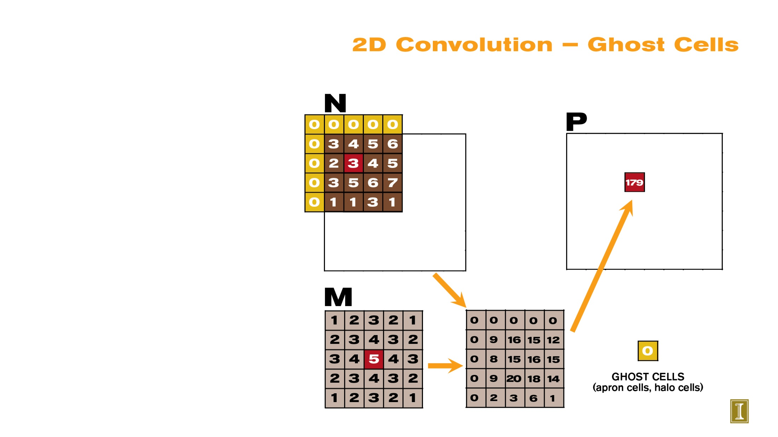
2D Convolution – Ghost Cells

Slide 12
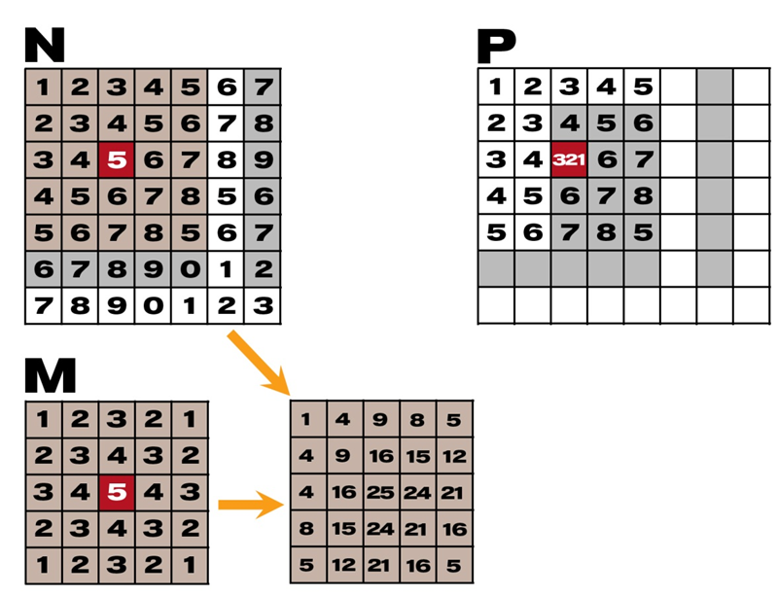
__global__
void convolution_2D_basic_kernel(unsigned char * in, unsigned char * mask, unsigned char * out,
int maskwidth, int w, int h) {
int Col = blockIdx.x * blockDim.x + threadIdx.x;
int Row = blockIdx.y * blockDim.y + threadIdx.y;
if (Col < w && Row < h) {
int pixVal = 0;
N_start_col = Col – (maskwidth/2);
N_start_row = Row – (maskwidth/2);
// Get the of the surrounding box
for(int j = 0; j < maskwidth; ++j) {
for(int k = 0; k < maskwidth; ++k) {
int curRow = N_Start_row + j;
int curCol = N_start_col + k;
// Verify we have a valid image pixel
if(curRow > -1 && curRow < h && curCol > -1 && curCol < w) {
pixVal += in[curRow * w + curCol] * mask[j*maskwidth+k];
}
}
}
// Write our new pixel value out
out[Row * w + Col] = (unsigned char)(pixVal);
}
}
Col
Row

Slide 13
__global__
void convolution_2D_basic_kernel(unsigned char * in, unsigned char * mask, unsigned char * out,
int maskwidth, int w, int h) {
int Col = blockIdx.x * blockDim.x + threadIdx.x;
int Row = blockIdx.y * blockDim.y + threadIdx.y;
if (Col < w && Row < h) {
int pixVal = 0;
N_start_col = Col – (maskwidth/2);
N_start_row = Row – (maskwidth/2);
// Get the of the surrounding box
for(int j = 0; j < maskwidth; ++j) {
for(int k = 0; k < maskwidth; ++k) {
int curRow = N_Start_row + j;
int curCol = N_start_col + k;
// Verify we have a valid image pixel
if(curRow > -1 && curRow < h && curCol > -1 && curCol < w) {
pixVal += in[curRow * w + curCol] * mask[j*maskwidth+k];
}
}
}
// Write our new pixel value out
out[Row * w + Col] = (unsigned char)(pixVal);
}
}
N_start_col
N_start_row

Slide 14
__global__
void convolution_2D_basic_kernel(unsigned char * in, unsigned char * mask, unsigned char * out,
int maskwidth, int w, int h) {
int Col = blockIdx.x * blockDim.x + threadIdx.x;
int Row = blockIdx.y * blockDim.y + threadIdx.y;
if (Col < w && Row < h) {
int pixVal = 0;
N_start_col = Col – (maskwidth/2);
N_start_row = Row – (maskwidth/2);
// Get the of the surrounding box
for(int j = 0; j < maskwidth; ++j) {
for(int k = 0; k < maskwidth; ++k) {
int curRow = N_Start_row + j;
int curCol = N_start_col + k;
// Verify we have a valid image pixel
if(curRow > -1 && curRow < h && curCol > -1 && curCol < w) {
pixVal += in[curRow * w + curCol] * mask[j*maskwidth+k];
}
}
}
// Write our new pixel value out
out[Row * w + Col] = (unsigned char)(pixVal);
}
}

Slide 15
The GPU Teaching Kit is licensed by NVIDIA and the University of Illinois under the Creative Commons Attribution-NonCommercial 4.0 International License.

